Slide 1


Team 7(CurryAi)
July 13, 2023
Weather
App
Jairo
Sebastian
Anu
Nadi Kyaw
Let's reflect on what went well and what did not go well to improve the way we work.
Parvathy
Luis
Almaz

Slide 2

Team 7(CurryAi)
July 13, 2023
1
Introduction to the Session
Today's
Agenda
2
Codes Explanation
3
Website Building
4
Q&A Session

Slide 3

Team 7(CurryAi)
July 13, 2023
Introduction
Sebastian
Anu
Jairo
Nadi
Parvathy
Luis
Almaz
They will be our facilitators for this session.

Slide 4

Team 7(CurryAi)
July 13, 2023
Are you ready?
Let's Start!

Slide 5
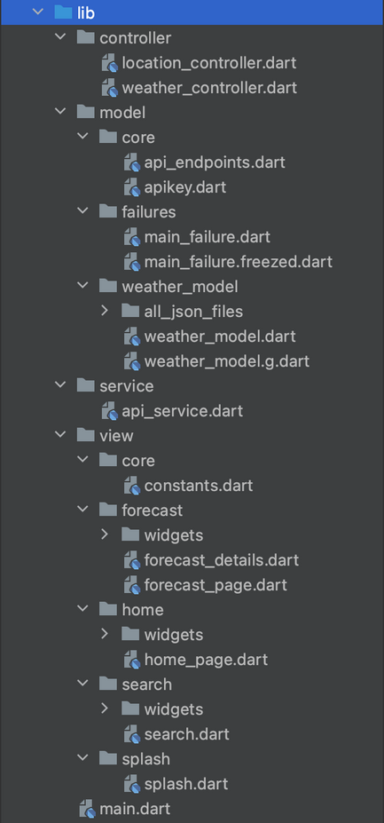
Team 7(CurryAi)
Lib
1
2
3
This is all the lib what we create and use them.

Slide 6
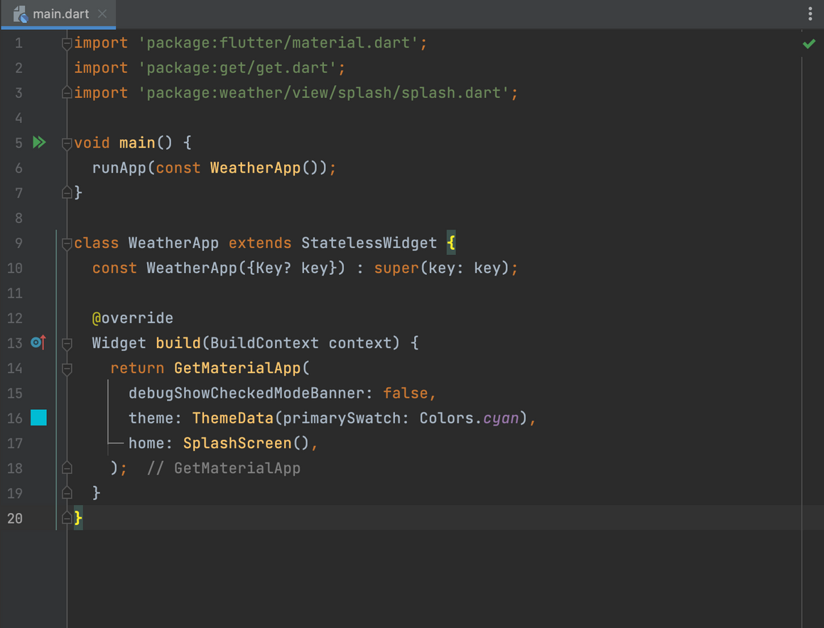
Team 7(CurryAi)
1
2
3
Main Dart
Import Statements:
'main()' Function:
'WeatherApp' Widget:
This code sets up the entry point of a Flutter application, configures the GetX package for state management and navigation, and defines a WeatherApp widget as the root of the application. It also specifies the initial screen to be the SplashScreen widget.

Slide 7
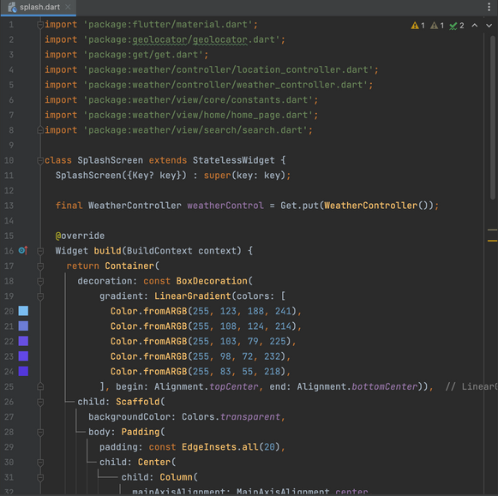
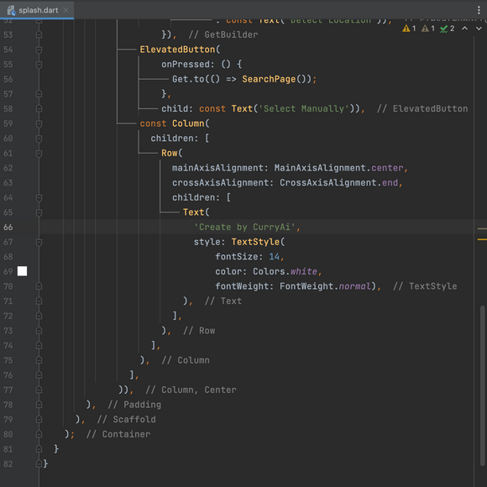
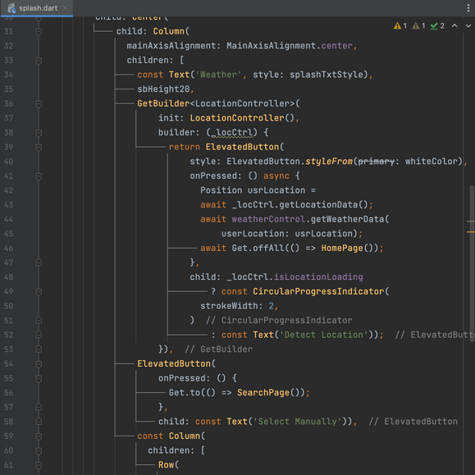
Team 7(CurryAi)
Splash
1
Copy a sticky note, then type in your idea.
What's your morning routine?
The provided code represents the `SplashScreen` widget in a Flutter weather app. It serves as the initial screen of the app and allows the user to detect their location automatically or manually select a location.
The `SplashScreen` widget creates a gradient background using a `Container` with a `LinearGradient`. Inside a `Scaffold`, it contains a `Column` widget that vertically centers its content. The content includes a "Weather" title, two `ElevatedButton` widgets, and a credit text.
The first `ElevatedButton` uses the `GetBuilder` widget with a `LocationController` to detect the user's location. It displays a circular progress indicator while loading and changes to "Detect Location" once the location is available. It retrieves weather data using the `WeatherController` and navigates to the `HomePage`.
The second `ElevatedButton` navigates to the `SearchPage` when pressed, allowing the user to manually select a location. The credit text acknowledges the creator of the app.
3
2

Slide 8
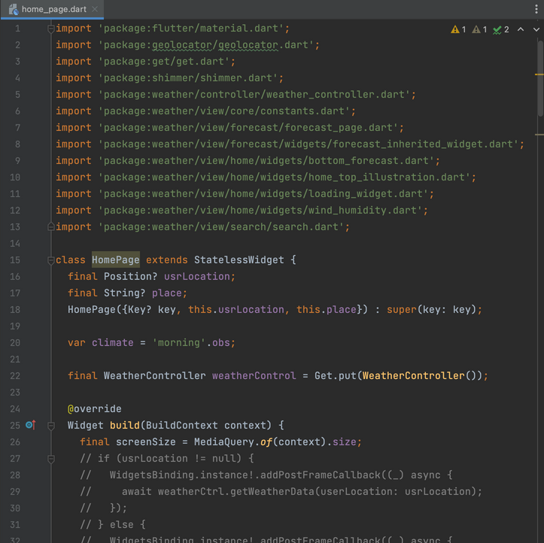
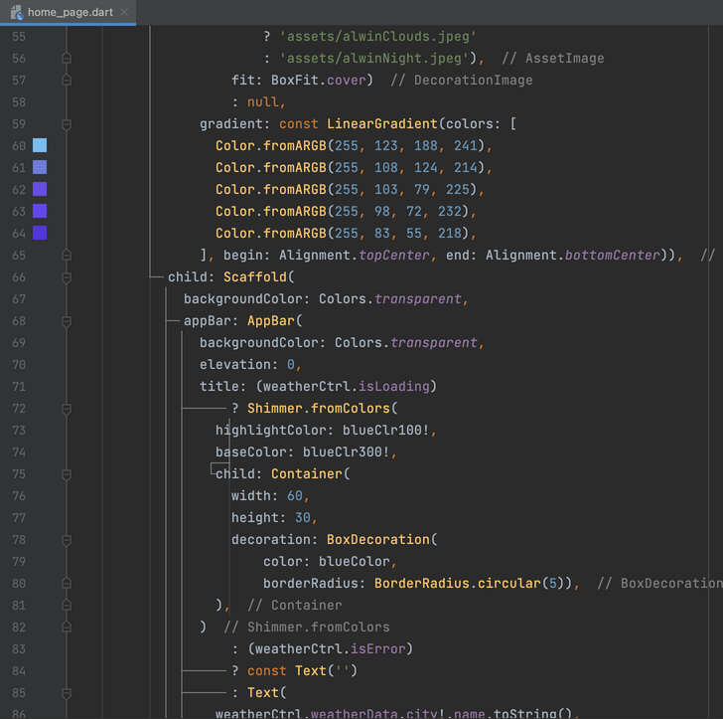
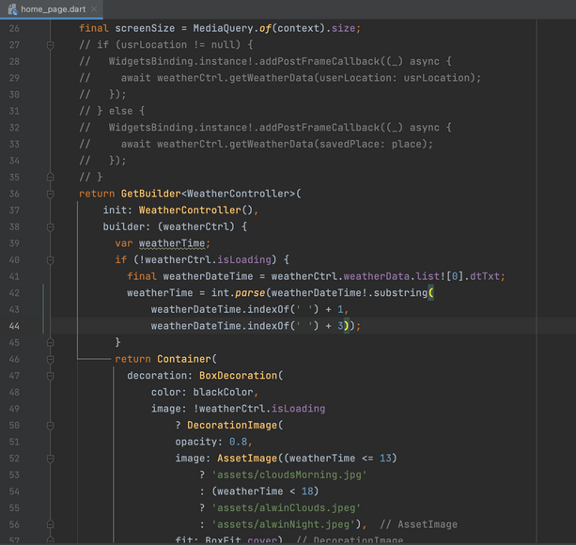
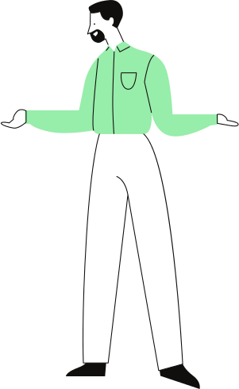
Homepage
1
Copy a sticky note, then type in your idea.
Copy a sticky note, then type in your idea.
Copy a sticky note, then type in your idea.
The provided code represents the `HomePage` widget in a Flutter weather app. This widget displays the main content of the app, including the current weather information, wind and humidity details, and a forecast for the next five days.
The `HomePage` widget receives the user's location (`usrLocation`) and the selected place (`place`) as optional parameters. It also initializes a `WeatherController` to handle weather-related functionality.
The widget's build method starts by obtaining the screen size and then creates a `Container` with a gradient background. If the weather data is not loading, an appropriate background image is displayed based on the current time.
Inside the `Container`, a `Scaffold` is used as the main structure of the page. It includes an `AppBar` that displays the app title, which is either a loading shimmer effect or the name of the city from the weather data. The app bar also includes a search button.
3
2
Team 7(CurryAi)

Slide 9
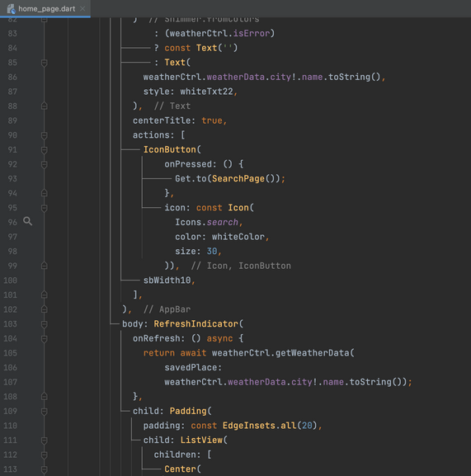
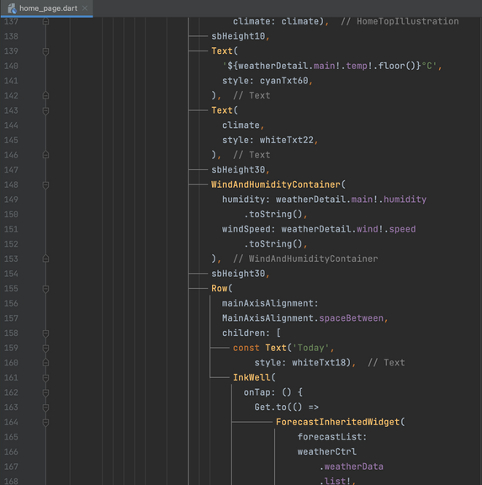
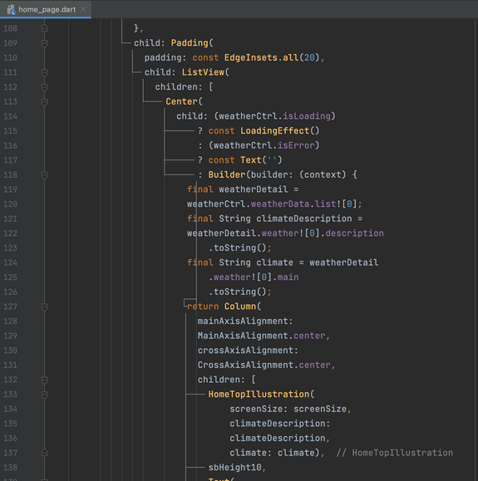
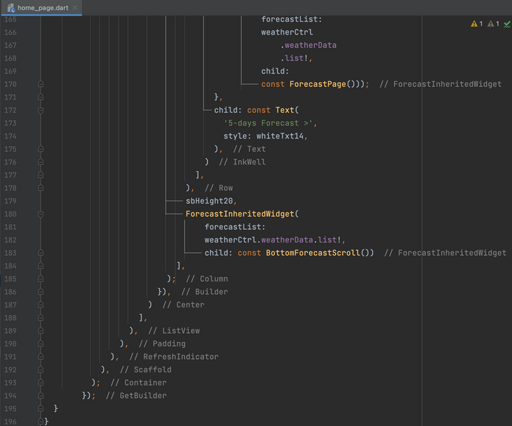
Homepage
The `body` of the `Scaffold` is a `ListView` wrapped in a `RefreshIndicator` to allow the user to pull down and refresh the weather data. Inside the `ListView`, the content is conditionally rendered based on the state of the weather data.
If the weather data is loading, a `LoadingEffect` widget is displayed. If there's an error, an empty `Text` widget is shown. Otherwise, the weather details are displayed, including an illustration, the current temperature, climate description, wind and humidity details, and a forecast section.
The forecast section includes a "Today" label and a clickable text to navigate to a forecast page showing the weather forecast for the next five days. Below that, a `BottomForecastScroll` widget displays a scrollable list of forecast items.
In summary, the `HomePage` widget represents the main screen of the weather app, displaying the current weather information and providing access to the forecast for the next five days. It handles loading and error states and allows the user to refresh the weather data and navigate to the search page. The widget also provides a visually appealing interface with background images and illustrations.
4
Copy a sticky note, then type in your idea.
Copy a sticky note, then type in your idea.
Copy a sticky note, then type in your idea.
6
5
7
Team 7(CurryAi)

Slide 10
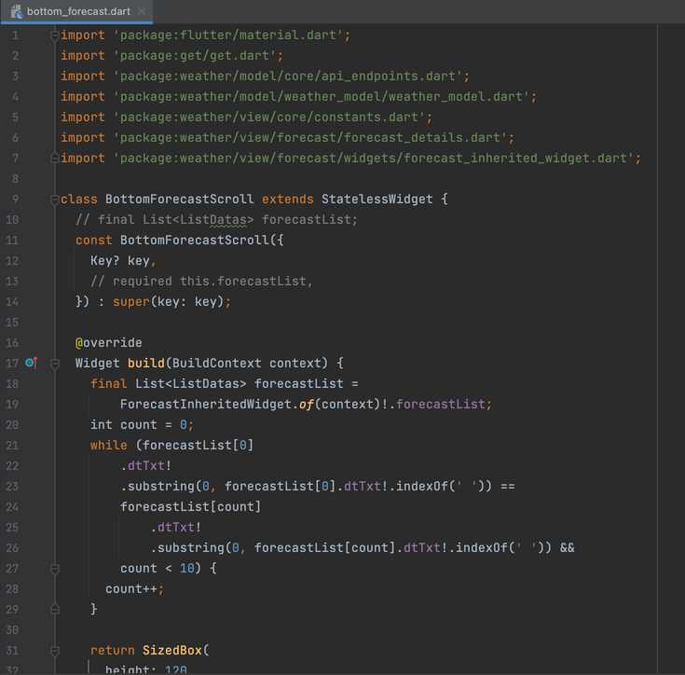
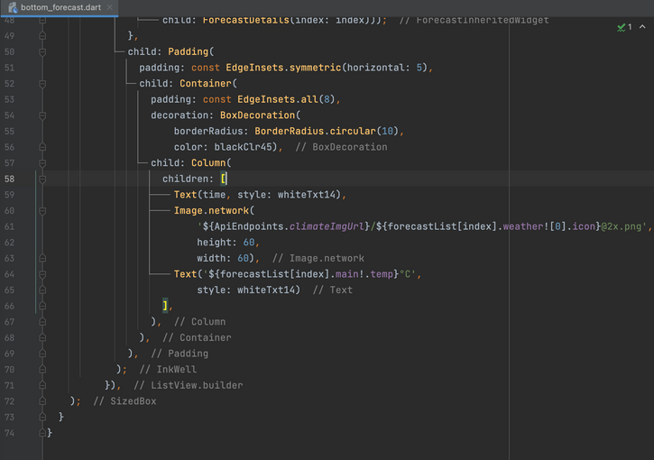
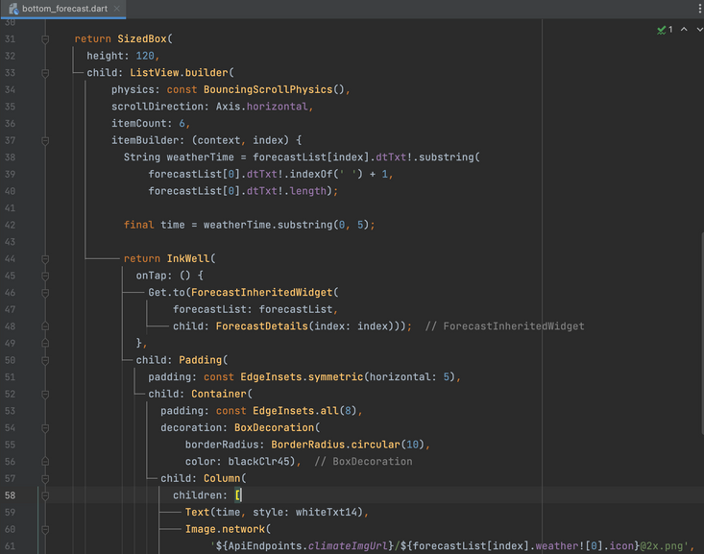

Team 7(CurryAi)
Copy a sticky note, then type in your idea.
Copy a sticky note, then type in your idea.
Copy a sticky note, then type in your idea.
Bottom Forecast
1
3
The 'BottomForecastScroll' widget is responsible for rendering a scrollable list of forecast items at the bottom of the home page. Each item displays the forecasted time, weather icon, and temperature. Tapping on an item navigates to a detailed forecast page. This widget contributes to providing users with an overview of the upcoming weather conditions.
2

Slide 11
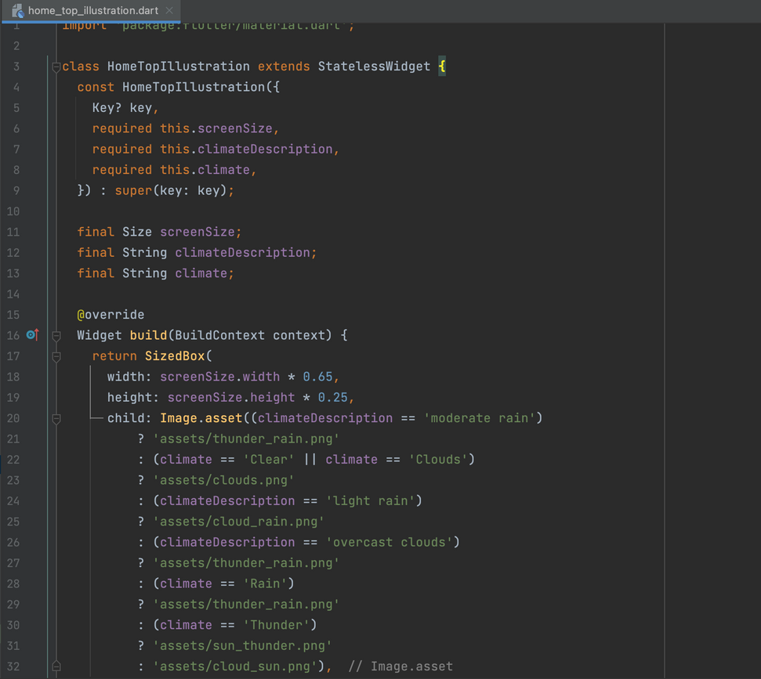
Team 7(CurryAi)
Copy a sticky note, then type in your idea.
Copy a sticky note, then type in your idea.
Copy a sticky note, then type in your idea.
Home Top Illustration
The 'HomeTopIllustration' widget is responsible for displaying an illustration at the top of the home page based on the current weather condition. It selects the image asset to show based on the climateDescription and climate parameters. This widget enhances the visual representation of the weather condition for users.

Slide 12
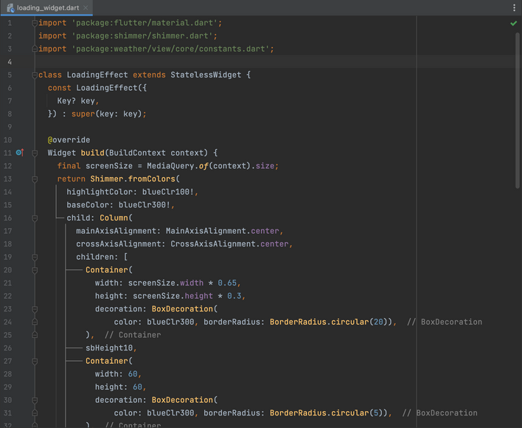
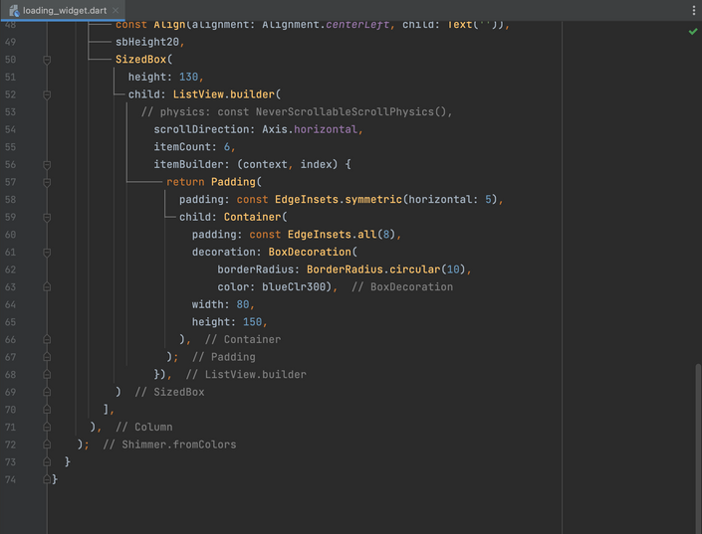
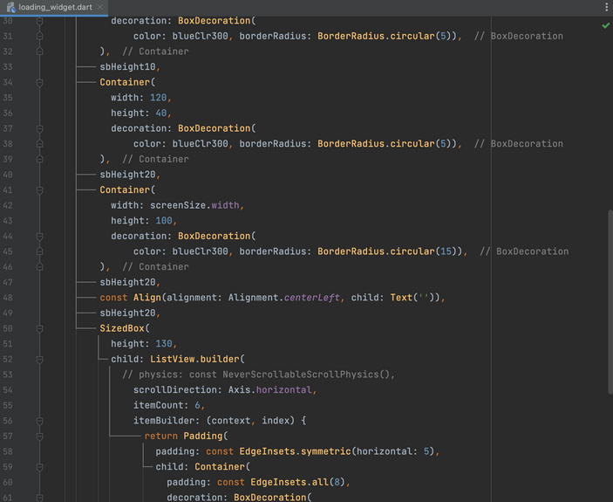

Team 7(CurryAi)
Loading Widget
1
The 'LoadingEffect' widget displays a shimmering loading effect with a column of containers representing different components of the weather app while data is being fetched or loaded. It provides a visual indication to the user that the app is in a loading state.
3
2

Slide 13
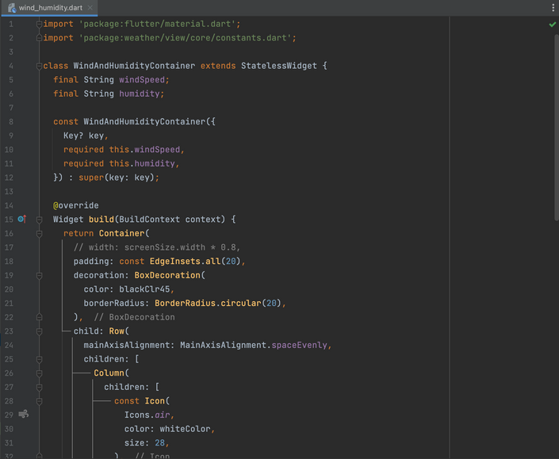
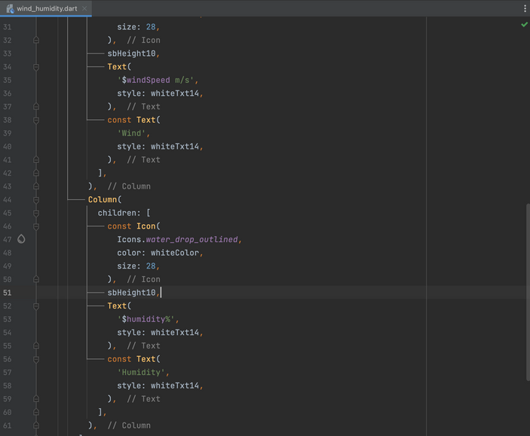
Team 7(CurryAi)
Wind Humidity
1
The 'WindAndHumidityContainer' widget displays wind speed and humidity information in a styled container. It uses icons, text, and styling to present the data in a visually appealing manner.
2

Slide 14
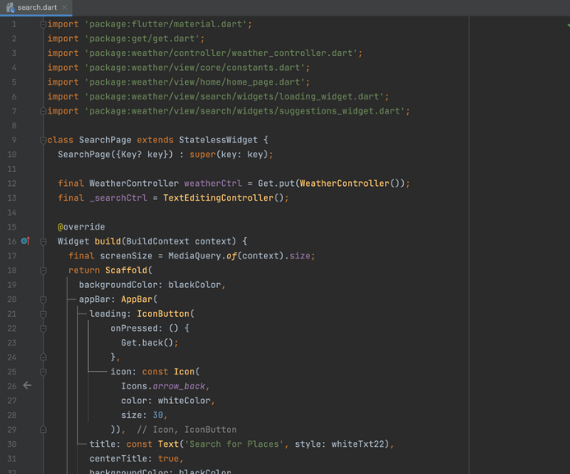
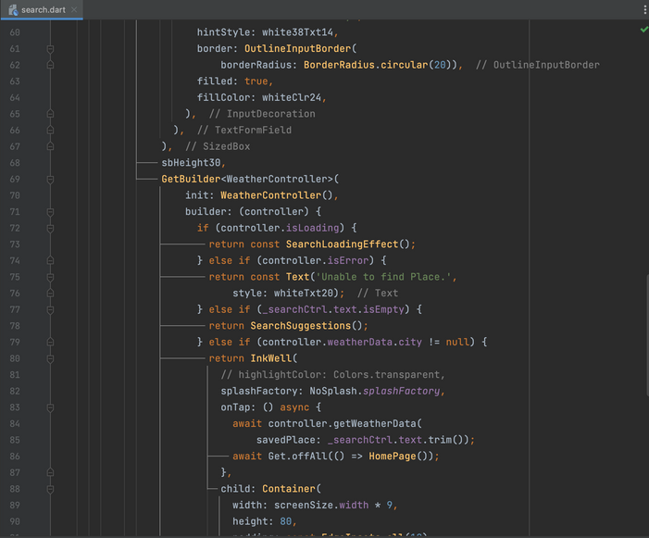
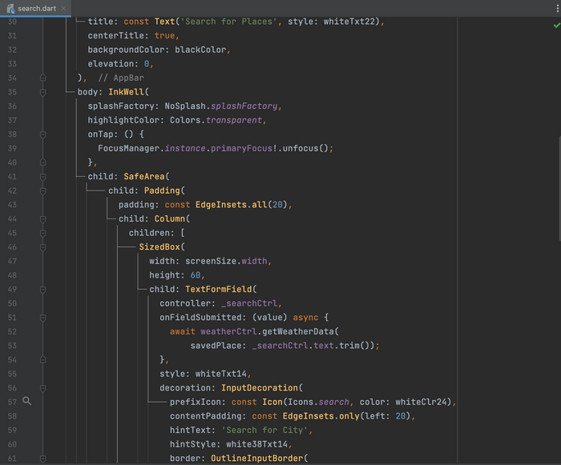
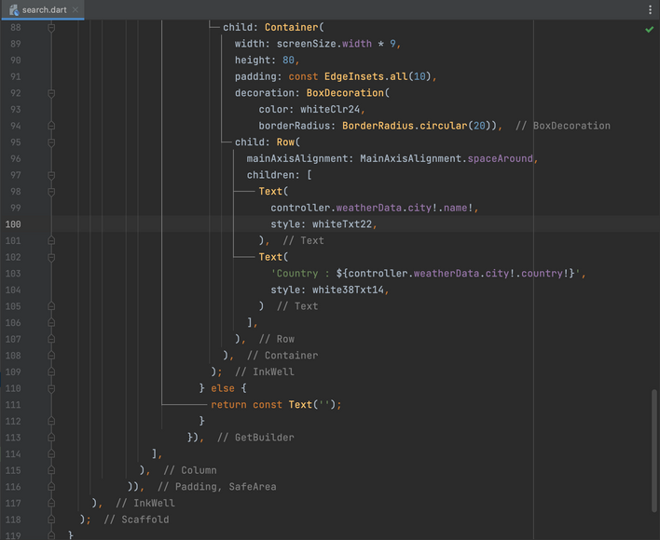

Team 7(CurryAi)
1
Search
3
The 'SearchPage' widget provides a search interface where users can enter a city name to search for weather information. It handles user input, displays search suggestions, shows loading and error states, and allows users to select a search result to view weather details on the 'HomePage'.
2
4

Slide 15
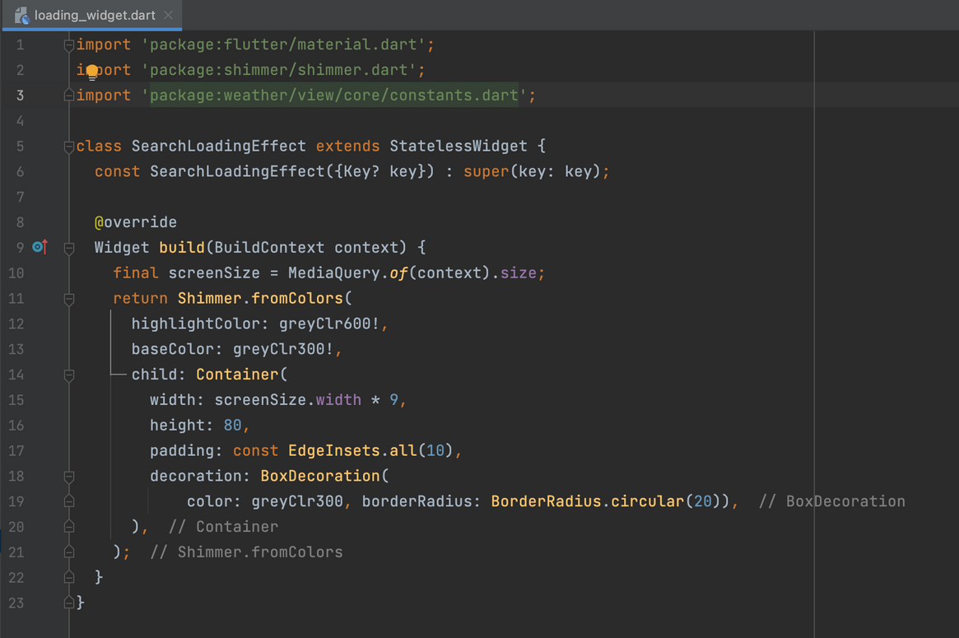
Team 7(CurryAi)
Loading Widget
The 'SearchLoadingEffect' widget creates a shimmering loading effect using the Shimmer package. It displays a container with a shimmer effect while search results are being fetched, providing a visual indication to the user that loading is in progress.

Slide 16
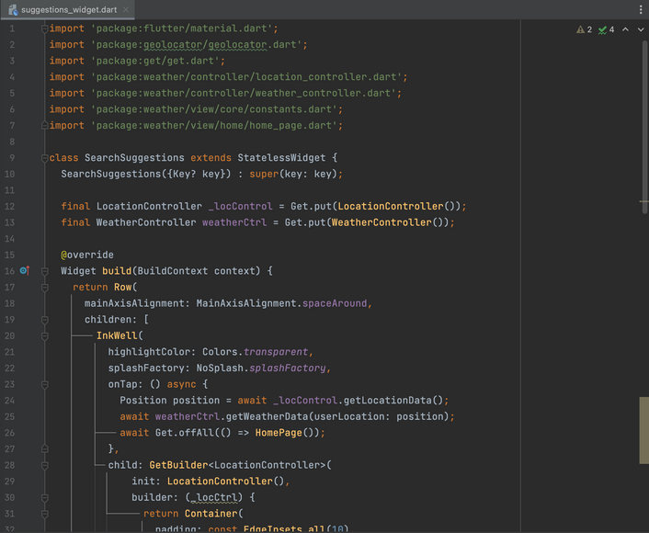
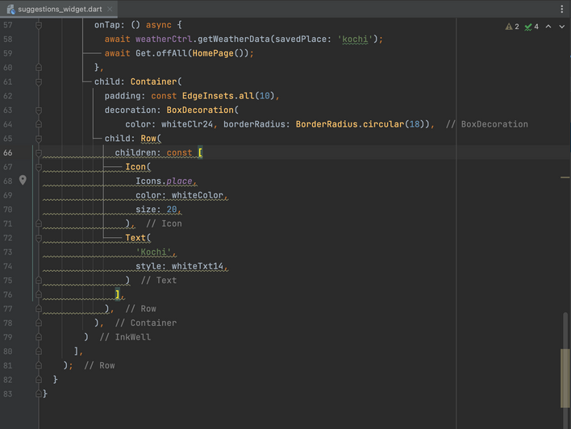
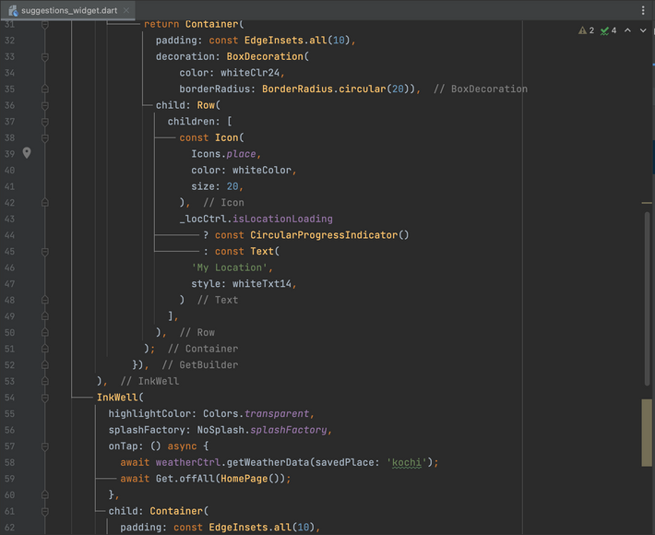
Team 7(CurryAi)
Copy a sticky note, then type in your idea.
Copy a sticky note, then type in your idea.
Copy a sticky note, then type in your idea.
Suggestions Widget
1
3
The 'SearchSuggestions' widget provides two search suggestions: "My Location" and "Yangon". It allows the user to select a suggestion, perform appropriate actions (such as retrieving location data or weather data), and navigate to the home page of the weather app.
2

Slide 17
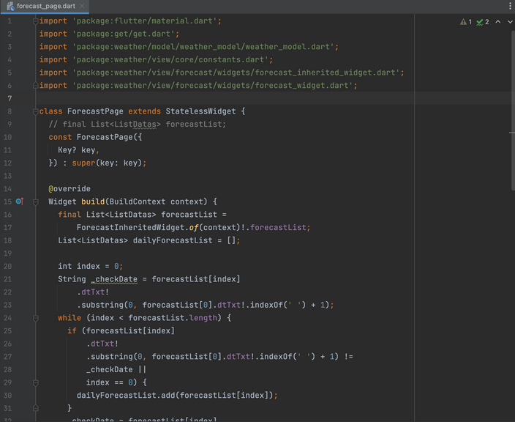
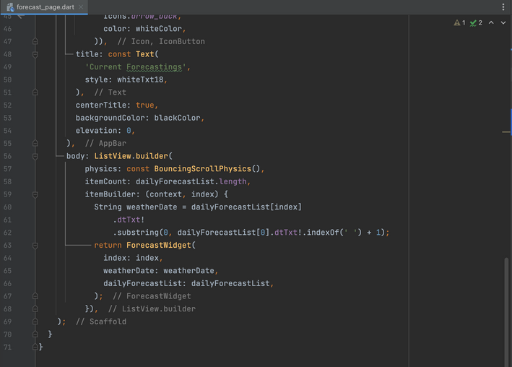
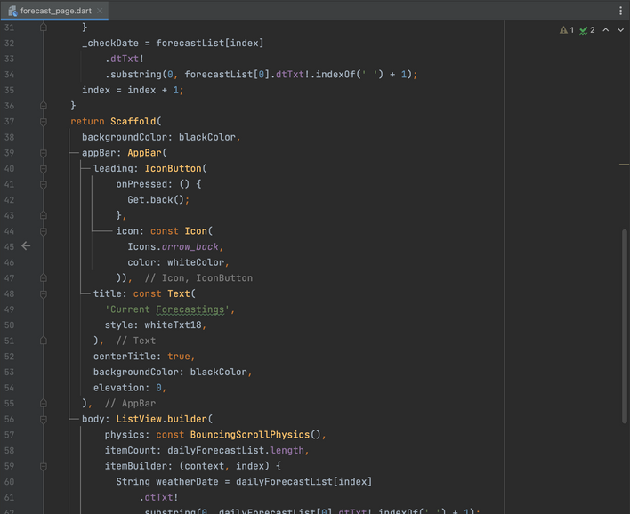
Team 7(CurryAi)
Copy a sticky note, then type in your idea.
Copy a sticky note, then type in your idea.
Copy a sticky note, then type in your idea.
Forecast Page
1
3
The 'ForecastPage' widget provides a page that displays the forecast for multiple days. It retrieves the forecast data from the 'ForecastInheritedWidget' and calculates the 'dailyForecastList' to group the forecast data by day. Each day's forecast is displayed using the 'ForecastWidget'. The page has an app bar with a back button and a title.
2

Slide 18
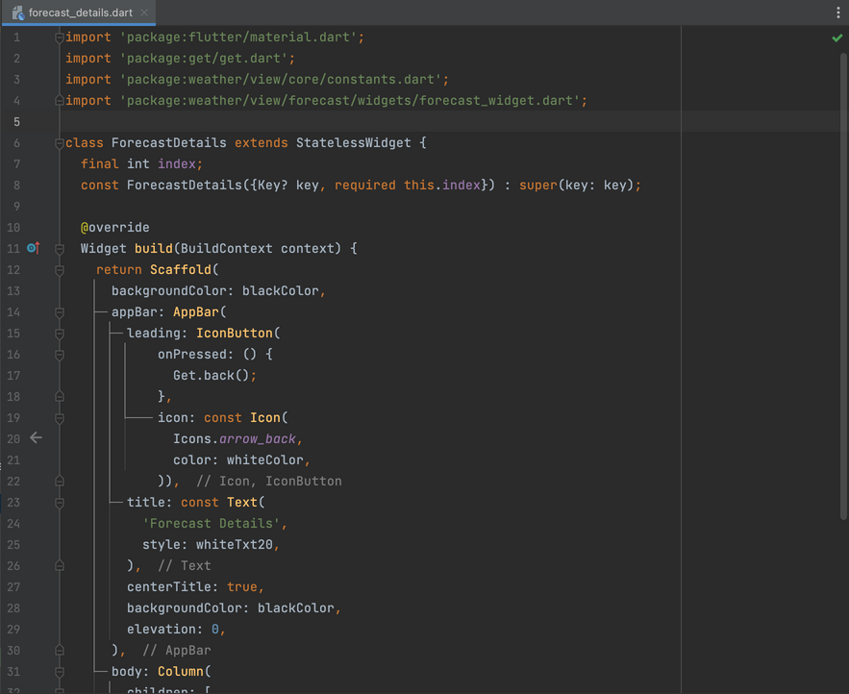
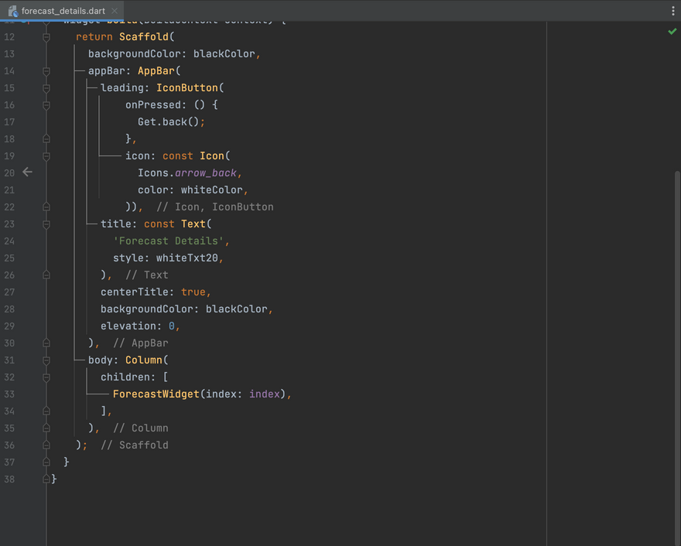
1
Team 7(CurryAi)
Copy a sticky note, then type in your idea.
Copy a sticky note, then type in your idea.
Copy a sticky note, then type in your idea.
Forecast Details
The 'ForecastDetails' widget provides a page that displays the detailed information of a specific forecast for a particular day. It has an app bar with a back button and a title. The body of the page contains the 'ForecastWidget' to display the forecast details.
2

Slide 19
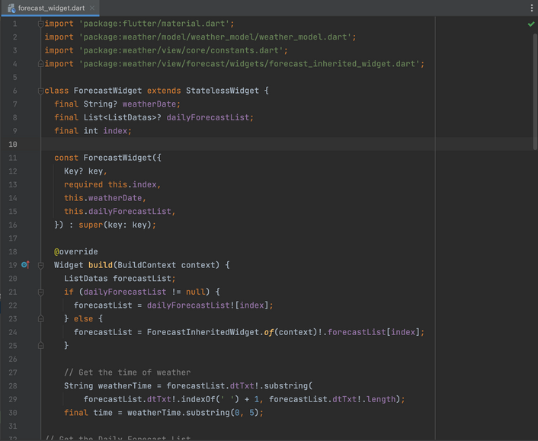
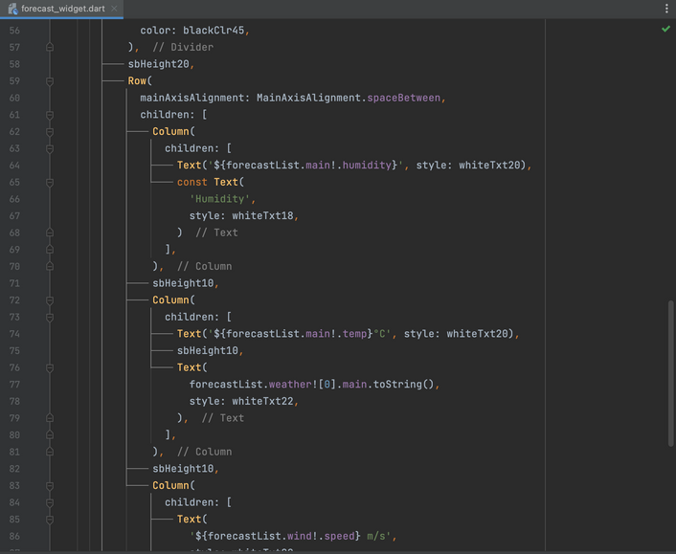
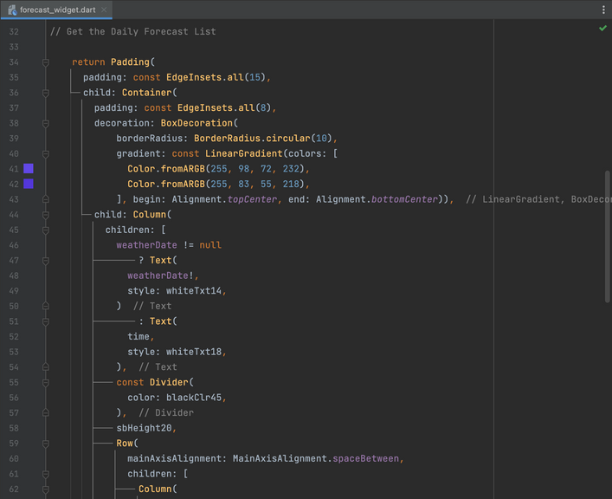
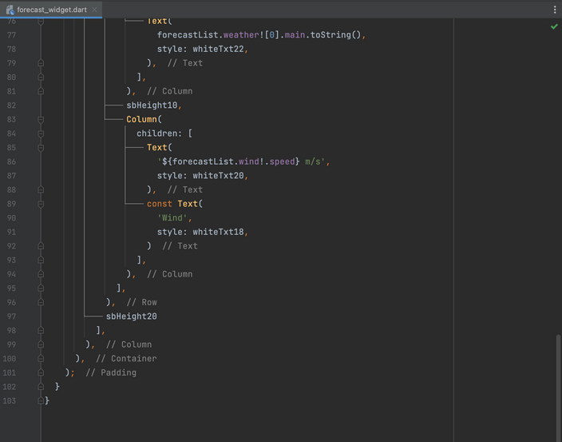
Team 7(CurryAi)
Copy a sticky note, then type in your idea.
Copy a sticky note, then type in your idea.
Copy a sticky note, then type in your idea.
Forecast Widget
1
The 'ForecastWidget' displays the detailed information for a specific forecast. It includes the date/time, humidity, temperature, weather condition, and wind speed. The widget's appearance is customized with padding, a rounded shape, and a gradient background. The data to display can be provided either through the 'weatherDate' and 'dailyForecastList' parameters or by accessing the data from the 'ForecastInheritedWidget'.
3
2
4

Slide 20
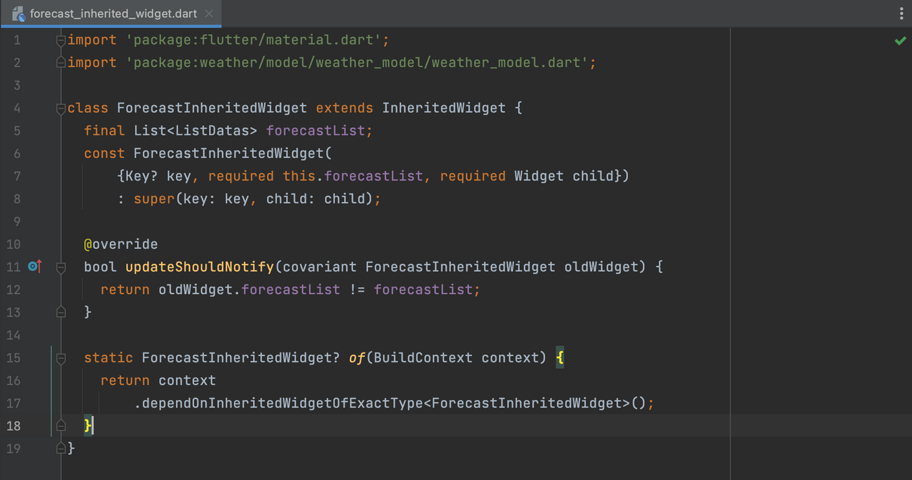
Team 7(CurryAi)
Copy a sticky note, then type in your idea.
Copy a sticky note, then type in your idea.
Copy a sticky note, then type in your idea.
Forecast Inherited Widget
The 'ForecastInheritedWidget' class allows the forecastList data to be shared with descendant widgets in the widget tree. It ensures that the descendant widgets are notified when the forecastList is updated. The 'of' method provides a way to access the 'ForecastInheritedWidget' instance from descendant widgets.

Slide 21
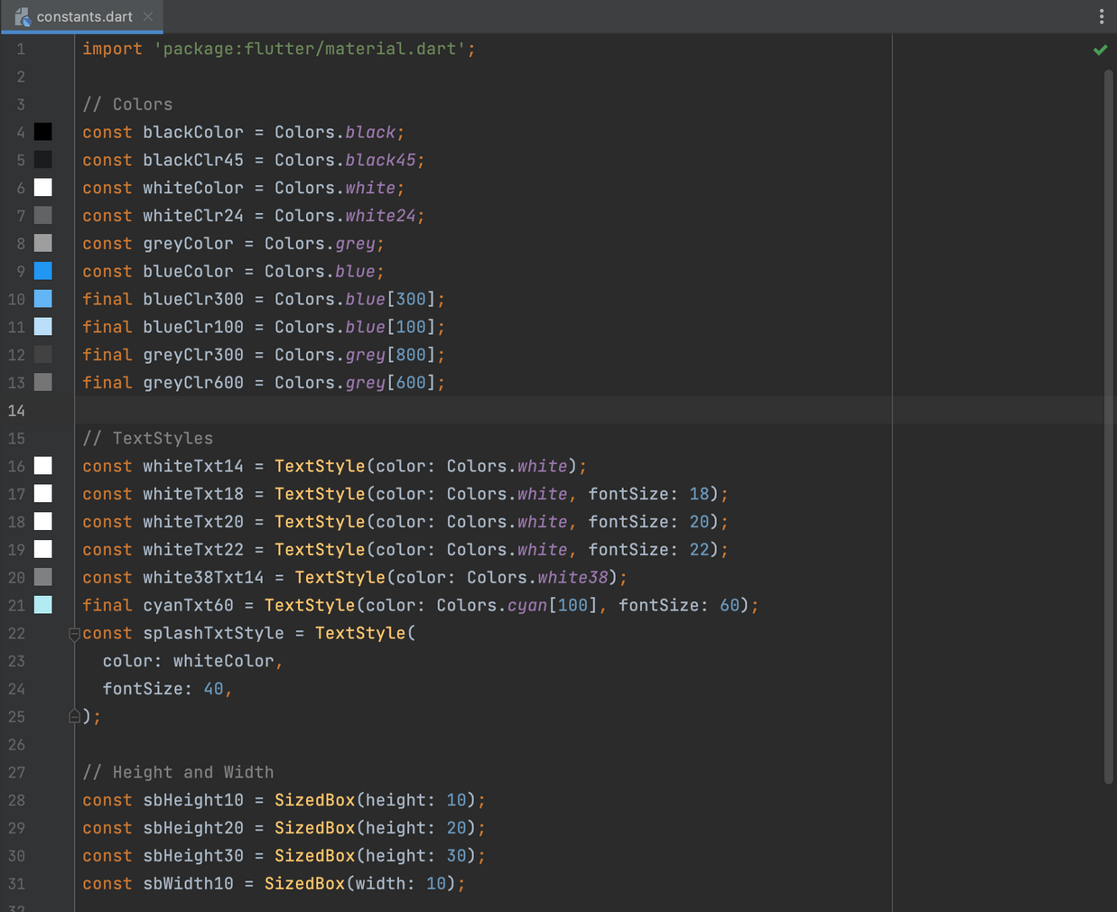

Team 7(CurryAi)
Copy a sticky note, then type in your idea.
Copy a sticky note, then type in your idea.
Copy a sticky note, then type in your idea.
Constants
The code defines various constants related to colors, text styles, and widget dimensions. These constants can be used throughout the application to ensure consistent styling and spacing.

Slide 22
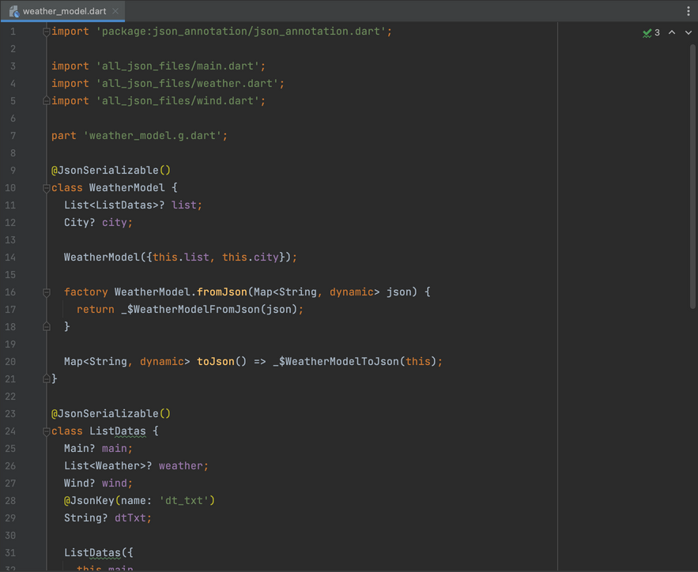
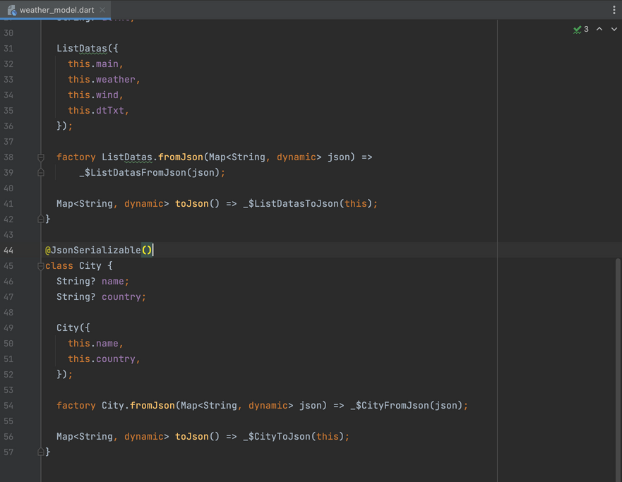
Team 7(CurryAi)
Copy a sticky note, then type in your idea.
Copy a sticky note, then type in your idea.
Copy a sticky note, then type in your idea.
Weather Model
1
The code defines the data model classes for parsing weather-related JSON data. These classes enable convenient conversion between JSON and Dart objects, allowing easy manipulation and access to weather data within the application.
2

Slide 23
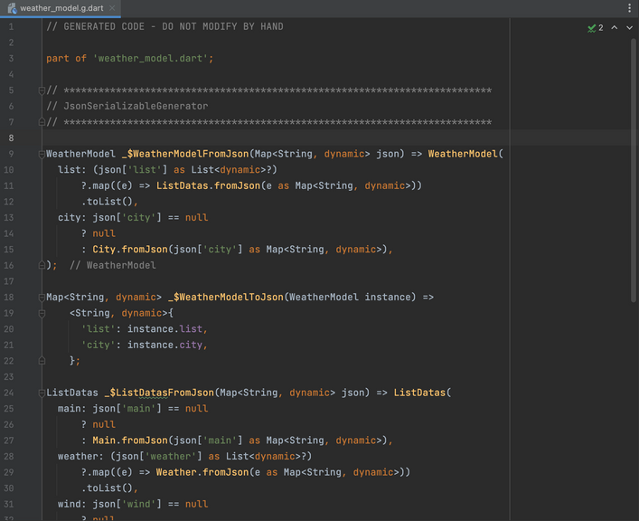
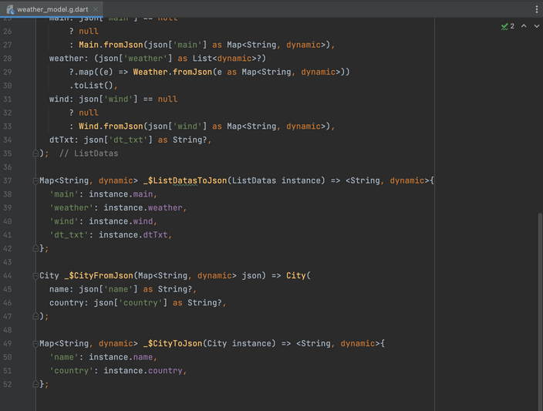
Team 7(CurryAi)
Copy a sticky note, then type in your idea.
Copy a sticky note, then type in your idea.
Copy a sticky note, then type in your idea.
Weather Model.G
1
This generated code provides the necessary functions to parse JSON data into Dart objects ('fromJson') and convert Dart objects to JSON ('toJson') for the 'WeatherModel', 'ListDatas', and 'City' classes defined in the 'weather_model.dart' file.
2

Slide 24
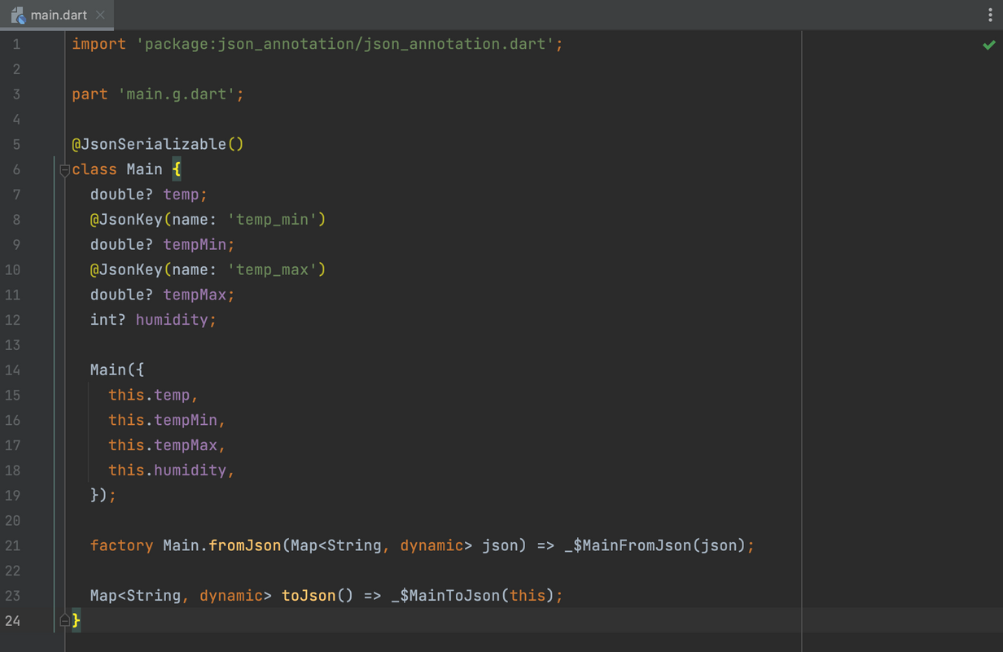
Team 7(CurryAi)
Copy a sticky note, then type in your idea.
Copy a sticky note, then type in your idea.
Copy a sticky note, then type in your idea.
Main(Json_File)
This code defines a 'Main' class that represents the main weather information. It includes methods to parse 'JSON' data into 'Main' objects ('fromJson') and convert 'Main' objects to JSON ('toJson'), leveraging the 'json_serializable' package for automatic code generation.

Slide 25
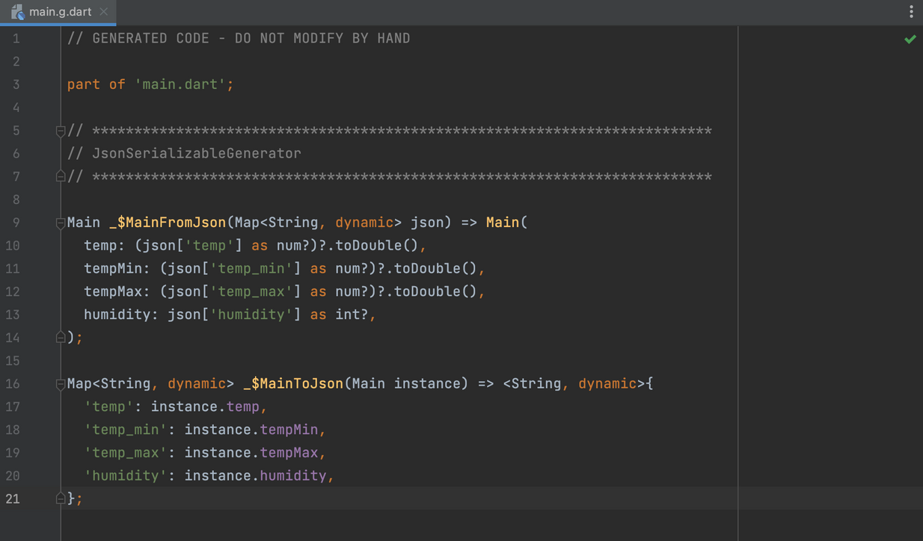
Team 7(CurryAi)
Copy a sticky note, then type in your idea.
Copy a sticky note, then type in your idea.
Copy a sticky note, then type in your idea.
Main.G(Json_File)
The generated code provides the implementation for converting 'Main' objects to JSON ('toJson') and parsing JSON data into 'Main' objects ('fromJson'). These methods are used to facilitate the serialization and deserialization of 'Main' objects to and from JSON format.

Slide 26
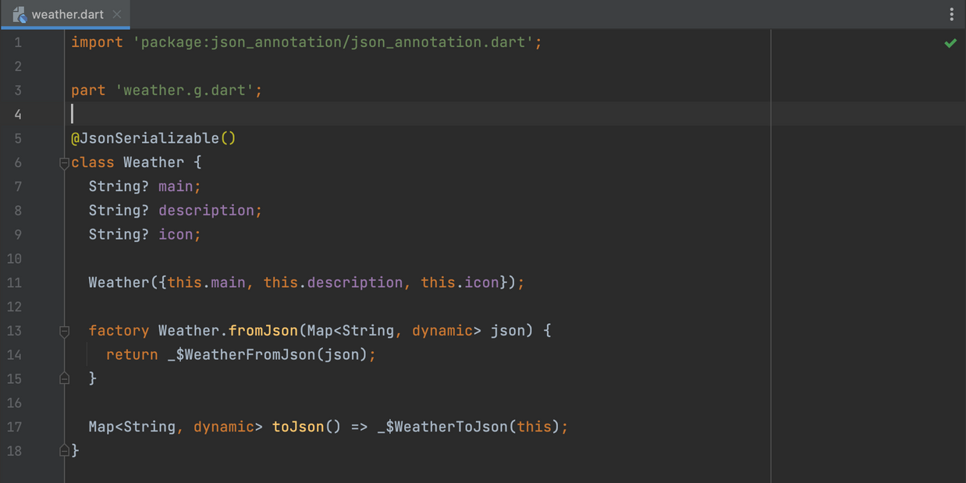
Team 7(CurryAi)
Copy a sticky note, then type in your idea.
Copy a sticky note, then type in your idea.
Copy a sticky note, then type in your idea.
Weather(Json_File)
The code defines the 'Weather' class and provides methods for converting 'Weather' objects to JSON ('toJson') and parsing JSON data into 'Weather' objects ('fromJson'). These methods facilitate the serialization and deserialization of 'Weather' objects to and from JSON format.

Slide 27
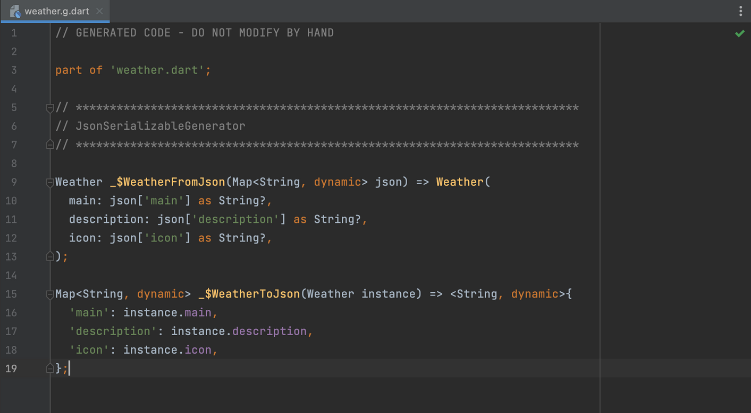
Team 7(CurryAi)
Copy a sticky note, then type in your idea.
Copy a sticky note, then type in your idea.
Copy a sticky note, then type in your idea.
Weather.G(Json_File)
This generated code provides the necessary functions to convert a 'Weather' object to JSON ('_$WeatherToJson') and parse a JSON object into a 'Weather' object ('_$WeatherFromJson'). These functions are automatically generated based on the annotations provided in the 'Weather' class.

Slide 28
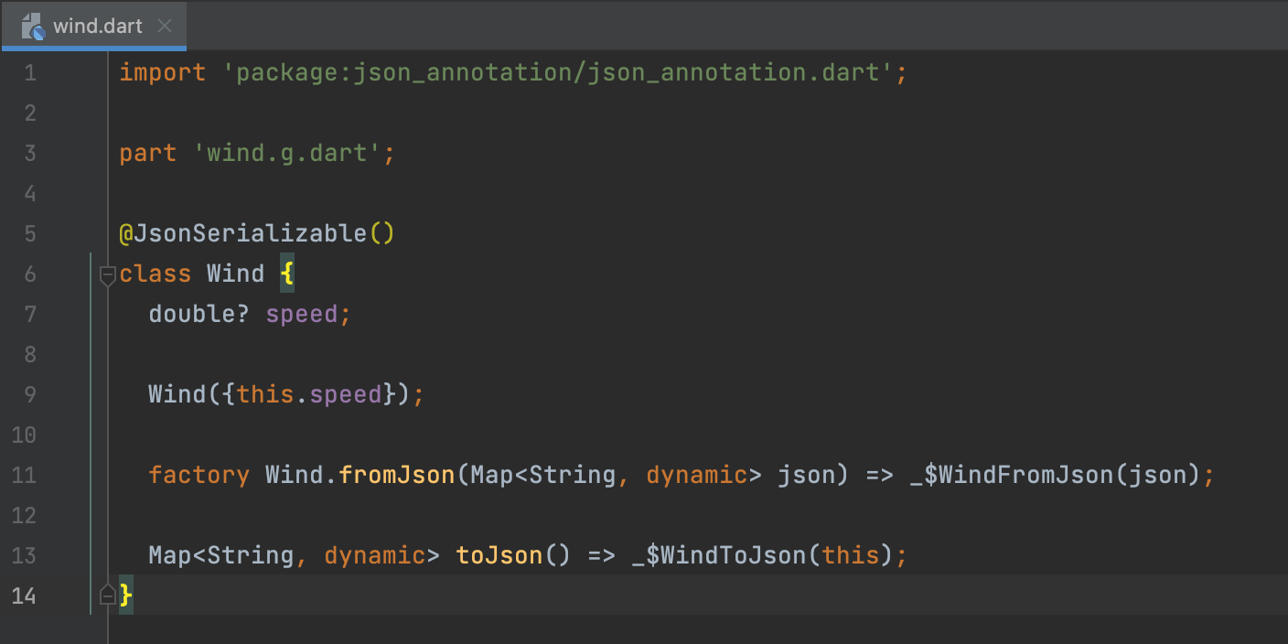
Team 7(CurryAi)
Copy a sticky note, then type in your idea.
Copy a sticky note, then type in your idea.
Copy a sticky note, then type in your idea.
Wind(Json_File)
This code provides the necessary functions to convert a 'Wind' object to JSON ('toJson') and parse a JSON object into a 'Wind' object ('fromJson'). These functions are automatically generated based on the annotations provided in the 'Wind' class.

Slide 29

Team 7(CurryAi)
Copy a sticky note, then type in your idea.
Copy a sticky note, then type in your idea.
Copy a sticky note, then type in your idea.
Wind.G(Json_File)
This generated code provides the implementation for converting a JSON object to a 'Wind' object ('_WindFromJson method') and converting a 'Wind' object to a JSON object ('_WindToJson method') based on the annotated properties of the 'Wind' class.

Slide 30

Team 7(CurryAi)
Main Failure
This code defines an immutable class 'MainFailure' with two factory constructors ('clientFailure' and 'serverFailure') that can be used to create instances representing different types of failures related to the 'Main' class. The 'freezed_annotation' package generates the necessary code for pattern matching and exhaustiveness checking when working with these failure instances.

Slide 31




Team 7(CurryAi)
Main Failure.Freezed
1
3
This code is generated code that complements the 'MainFailure' class and provides implementations for pattern matching, copying, and handling different failure cases. It allows for safer and more structured handling of failures related to the 'Main' class.
2
4

Slide 32






Team 7(CurryAi)
Main Failure.Freezed
5
7
9
6
8
10

Slide 33



Team 7(CurryAi)
Location Controller
1
3
The code provides functionality to retrieve the current device position using the 'Geolocator' package. The 'LocationController' class manages the loading state while retrieving the location data, and the 'GetPosition' function is a standalone function to retrieve the current position.
2

Slide 34

Team 7(CurryAi)
Weather Controller
The code provides functionality to fetch weather data using an API service ('ApiService'). The 'WeatherController' class manages the loading and error states while fetching the weather data. It also updates the 'weatherData' variable with the retrieved weather data.

Slide 35

Team 7(CurryAi)
Api Key
The 'ApiKeys' class and 'apiKey' constant are used to store an API key (in this case, for weather-related APIs) or any other sensitive information that needs to be accessed within the code. By storing the key as a constant, it can be easily referenced and used throughout the codebase.

Slide 36

Team 7(CurryAi)
Api Endpoints
The 'ApiEndpoints' class provides static constant variables that store the URLs for various API endpoints related to weather data retrieval and climate images. These URLs are constructed using the base API endpoints, query parameters, and the 'apiKey' variable from the 'apikey.dart' file. This approach helps in centralizing and organizing the API endpoints in one place for easier management and access throughout the codebase.

Slide 37

Team 7(CurryAi)
Api Service
The 'ApiService' class provides a method 'getWeather' that makes API requests to retrieve weather data based on a provided location or user's current position. It uses the 'Dio' library for network requests and handles both successful responses and potential failures. The method returns an 'Either' type, allowing the caller to handle both success and failure cases appropriately.

Slide 38


Team 7(CurryAi)
Copy a sticky note, then type in your idea.
Copy a sticky note, then type in your idea.
Copy a sticky note, then type in your idea.
Pubspec.yaml
This is what we add-in and use.

Slide 39
Team 7(CurryAi)
July 13, 2023
Weather
Website

Slide 40

Team 7(CurryAi)
Home
Page

Slide 41



index.html
This code sets up the basic structure of a weather app website with a navigation bar, a weather search bar, and weather information display. It also includes the integration of an OpenWeatherMap widget for enhanced weather data.

Slide 42



index.js
This code adds functionality to a weather search feature that fetches weather data from the OpenWeatherMap API based on the user's input. It updates the webpage with the weather information and handles error cases if the city is not found.
Team 7(CurryAi)

Slide 43

Team 7(CurryAi)
Search
Bar

Slide 44

Team 7(CurryAi)
About
Page

Slide 45


About.html
This code sets up the structure of an "About" page for the weather app website. It includes information about the project and its features, as well as an additional weather widget for users to explore more forecasts.

Slide 46

Team 7(CurryAi)
Contact
Page

Slide 47




contact.html
This code sets up the structure of a "Contact Us" page with a contact form and additional information about the team members. It utilizes Bootstrap for responsive design and form validation, along with custom CSS and JavaScript files for further customization and functionality.

Slide 48














Team 7(CurryAi)
July 13, 2023
Let's go back to the previous pages and identify actions we can enhance or new steps we should start doing so we can improve the way we work.
Action Items
1
2
3
4
Copy a sticky note and write action items you can do.
Vote for our favorite ideas with stars.
Circle or mark up any promising ideas.
Work Together
Add your thought here
Add your thought here
Add your thought here
yes!
this is great
Add your thought here
Add your thought here
Add your thought here

Slide 49


Team Retro
What went well
What didn't go well
Action Items
1
Add your thought here
Add your thought here
Add your thought here
2
3
Copy a sticky note and write down your thoughts.
yes!
Vote for your favorite
ideas with these stars or stickers.
Circle or
mark up any promising ideas.
this is great
Add your thought here
Add your thought here
Add your thought here

Slide 50
Team 7(CurryAi)
July 13, 2023
We're done!
Jairo Rodelo
Sebastian Albahaca
Anu
Thank you for participating. Have a great day ahead.
Nadi Kyaw
Parvathy Arun
Luis Arguello
Baizhan Khassenov
Almaz Arynov
Anelya Adakhayeva
Yeskendir Dauren

